Slide 1
SMART HOME AUTOMATION SYSTEM
PRESENTED BY- VANSH SHARMA
cs(iot)

Slide 2
OBJECTIVE
To develop a smart home automation system using Arduino.
Automate tasks such as:
Lighting control using LDR sensor.
Intrusion detection with PIR motion sensor.
Gas leak detection using MQ-2 sensor.
Smart door control with ultra sonic sensor and servo motor.
Display real time status and alerts on a LCD screen. Enhance safety,convenience ,and energy efficiency in the home environment.

Slide 3
COMPONENTS USED
Arduino UNO
LCD 16x2 Display
LDR Sensor
Gas Sensor (MQ-2)
PIR Motion Sensor
Ultrasonic Sensor
Servo motor
Buzzer
Relay module
Bread Board and wires
Power Supply
Slide Switch
Resistor
Bulb
Dc Motor

Slide 4
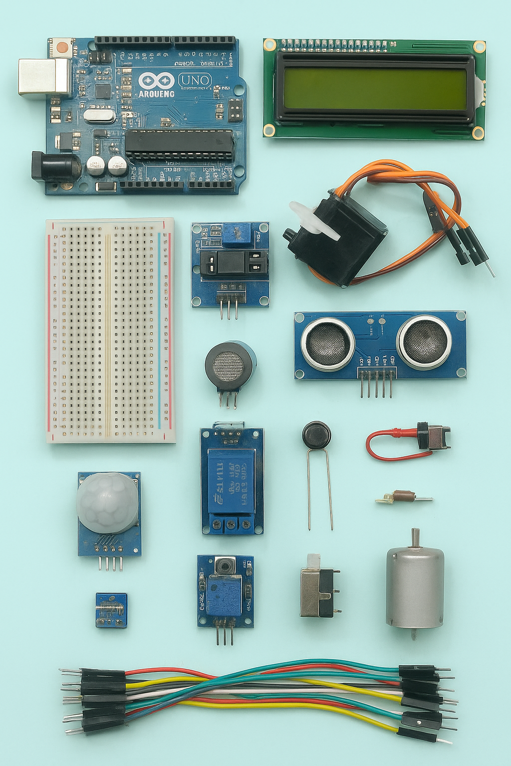

Slide 5
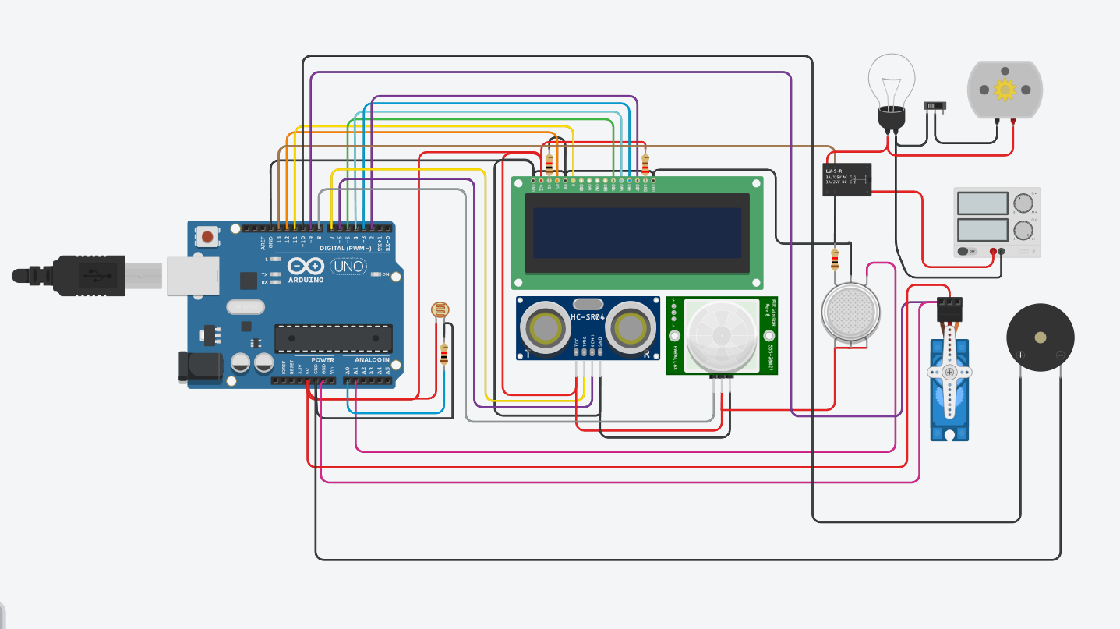
CIRCUIT DIAGRAM

Slide 6
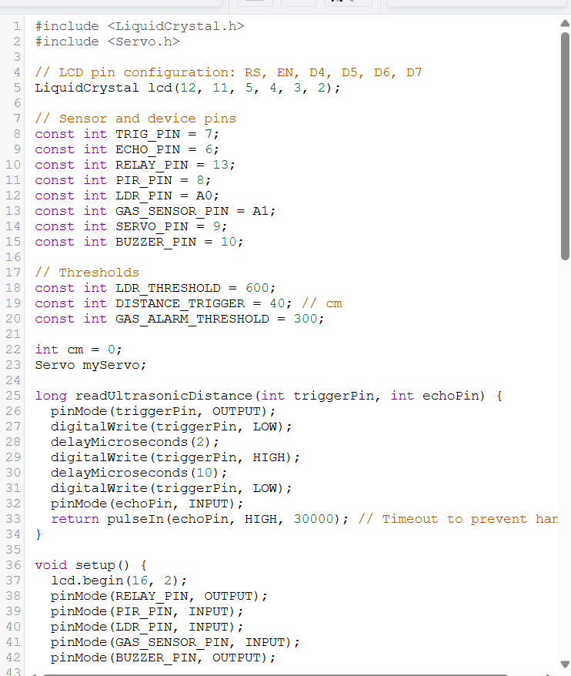
CODE

Slide 7
ARDUINO CODE OVERVIEW
LDR controls a relay to switch a bulb based on light intensity
PIR sensor detects motion and controls dc motor
GAS sensor detects LPG leakage and activates a buzzer
Ultrasonic sensor detects presence at door and activates servo
LCD displays sensor readings and system messages

Slide 8
LDR AND RELAY CONTROL
LDR Monitors ambient light
If light intensity <600, bulb turns OFF.
If >600, darkness bulb turns ON
LCD displays current light value and status

Slide 9
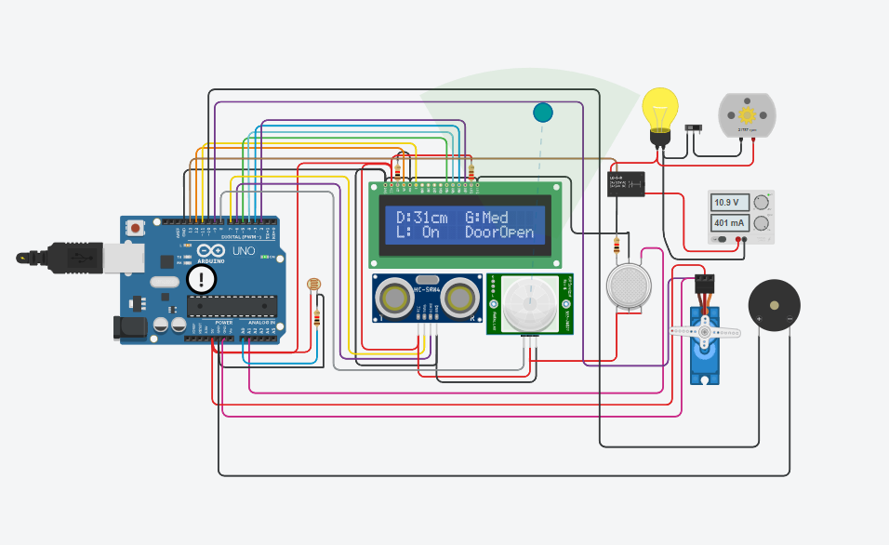
If light intensity>600, bulb turns ON

Slide 10
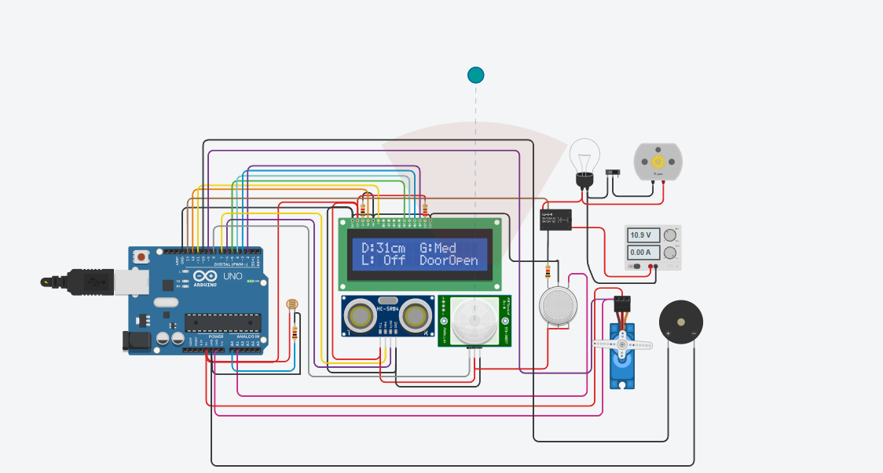
If light intensity<600, bulb turns OFF

Slide 11
PIR MOTION DETECTION
PIR sensor detects human movement
If motion detected: MOTOR ROTATES, BULB TURNS ON
If no motion detected: MOTOR STOPS, BULB TURNS OFF

Slide 12
WHEN MOTION DETECTED : MOTOR ROTATES, BULB TURNS ON

Slide 13
GAS DETECTION AND ALARM
MQ-2 gas sensor detects gas concentration.
If value <=85 LCD display LOW
If value <=120 LCD display MED
If value <=200 LCD display HIGH
If value <=300 LCD display EXT
If value above 300 then buzzer turns ON

Slide 14
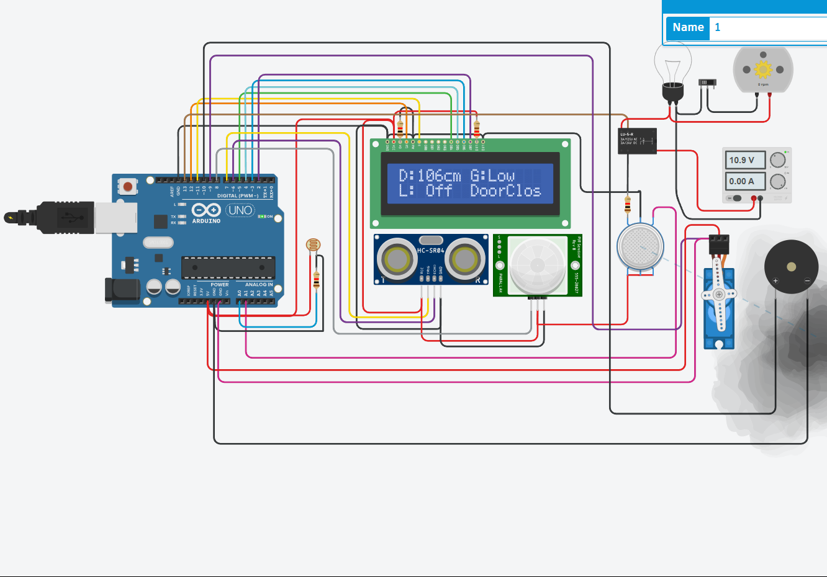
If value <=85 LCD display LOW

Slide 15
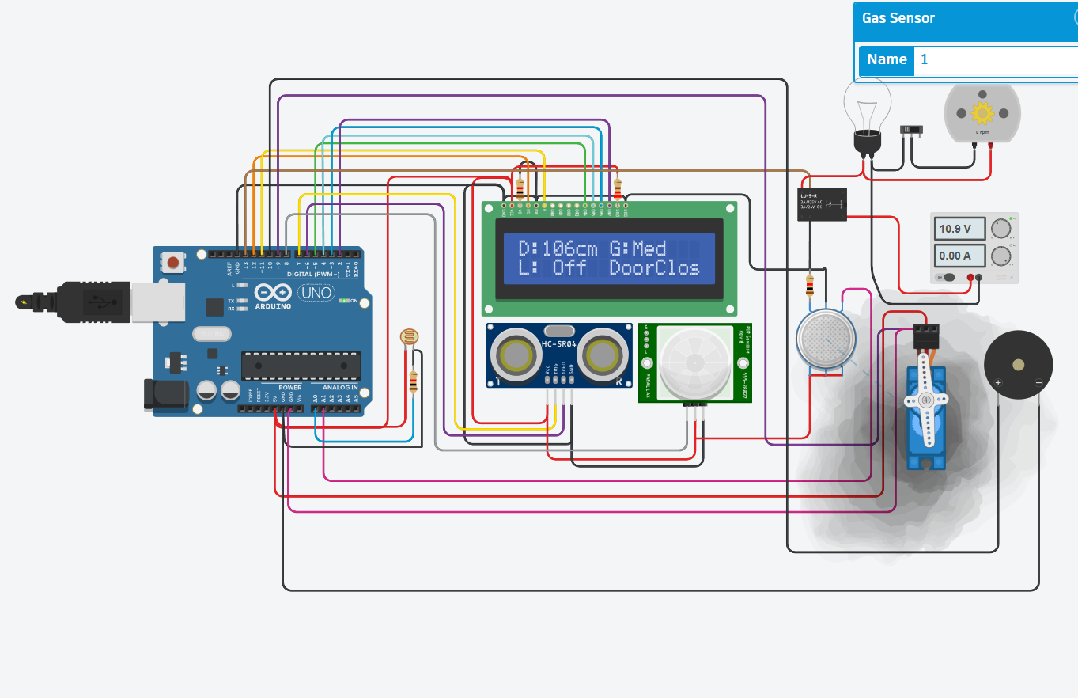
If value <=120 LCD display MED

Slide 16
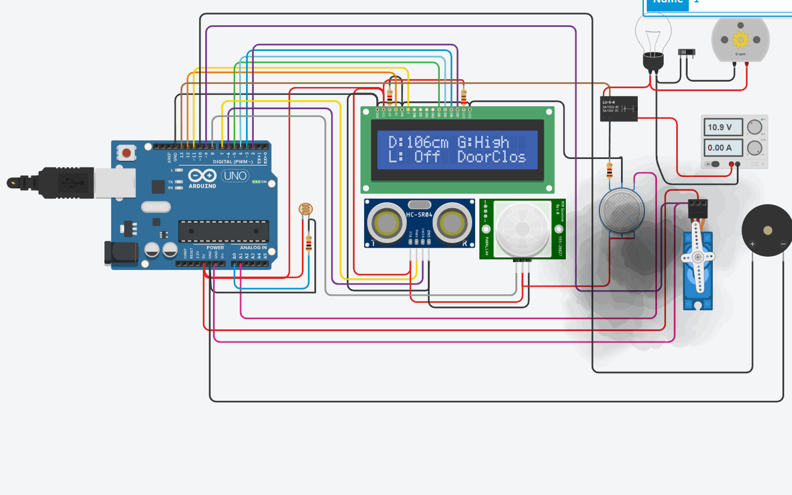
If value <=200 LCD display HIGH

Slide 17
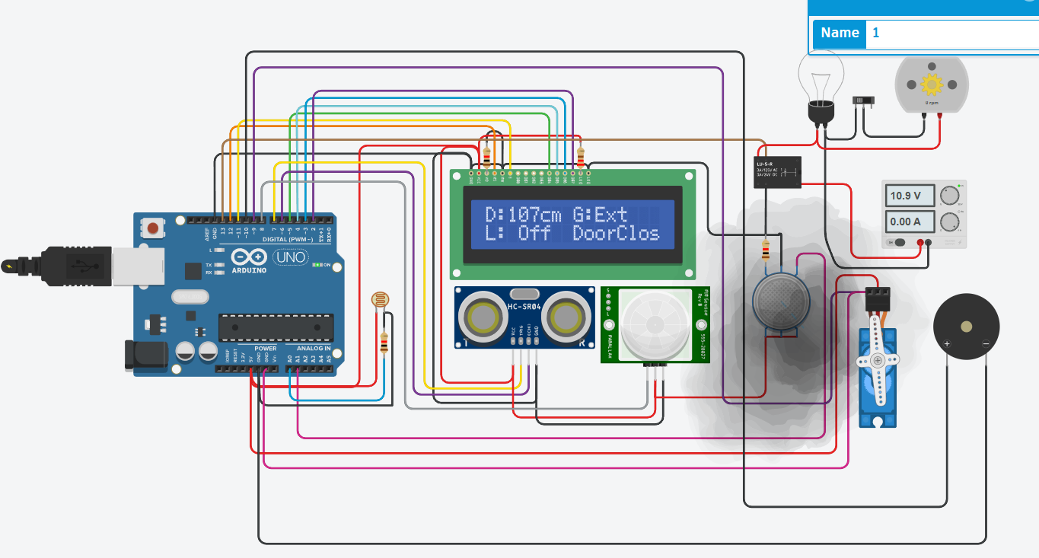
If value <=300 LCD display EXT

Slide 18
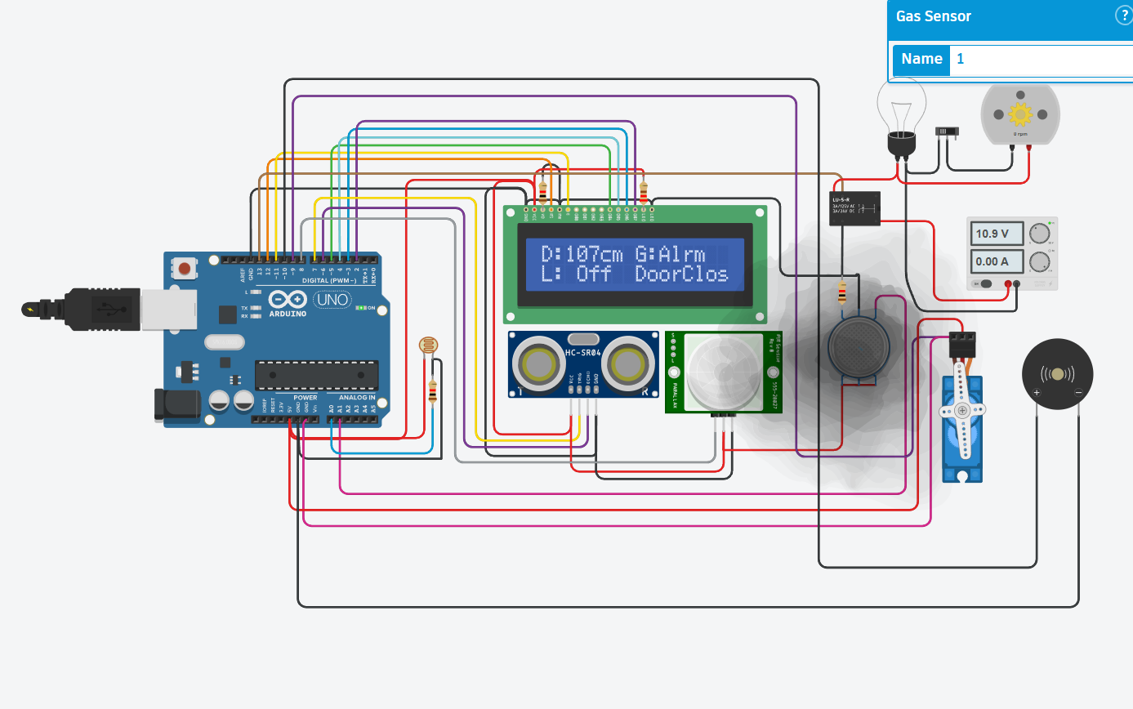
If value above 300 then buzzer turns ON

Slide 19
ULTRASONIC+SERVO FOR SMART DOOR
Ultrasonic Sensor measures distance.
If distance < 40 cm Servo rotates 90 DEGREE
LCD displays DOOR OPEN
If distance > 40 cm Servo = 0 DEGREE
LCD displays DOOR OFF

Slide 20
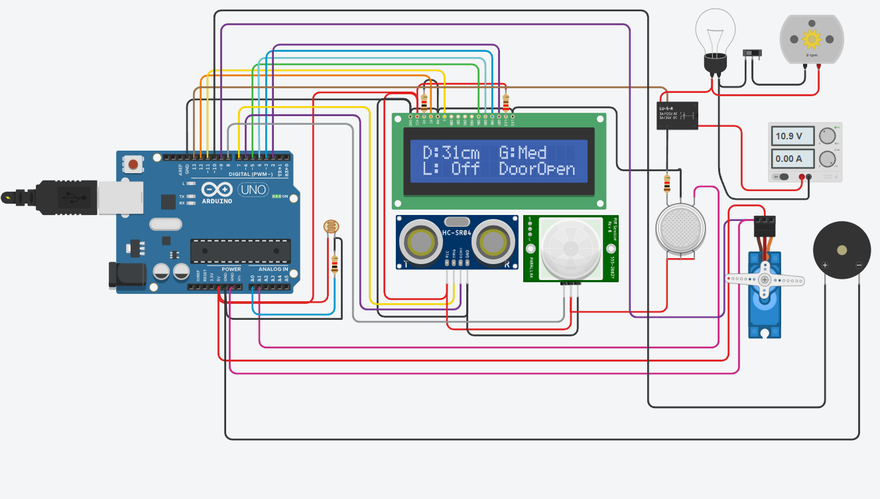
If distance < 40 cm Door OPENS

Slide 21
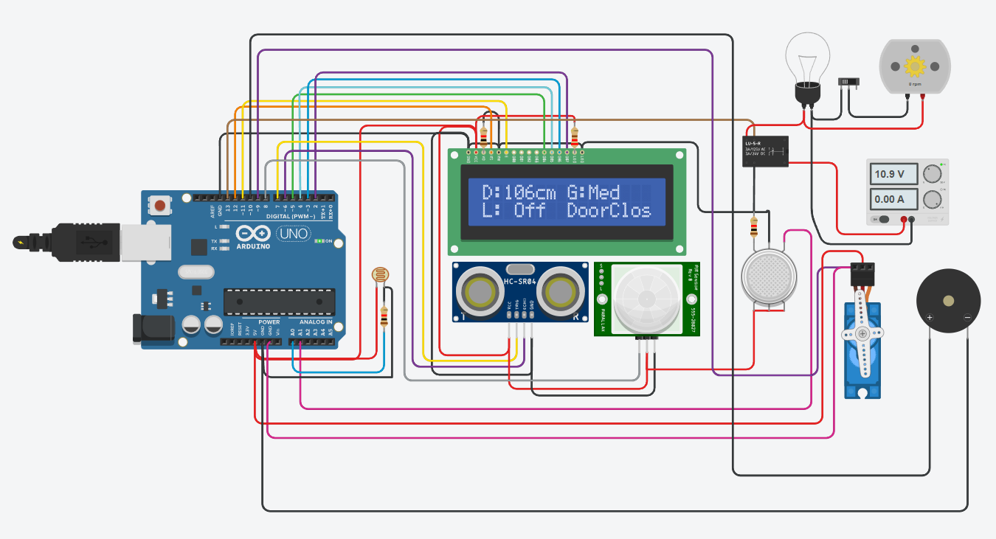
If distance > 40 cm Door closes

Slide 22
CONCLUSION
Integrates various sensors and modules into a smart home model.
Helps automate lighting, security, gas leakage alert, and door control.
Ideal for low-cost ,Arduino-based home automation projects.

Slide 23
THANK YOU

